Slide 1
Views Overview: Introduction to views as virtual tables derived from the result of a SELECT query.
SNEHA K

Slide 2
Views are a kind of virtual table. A view also has rows and columns like tables, but a view doesn’t store data on the disk like a table. View defines a customized query that retrieves data from one or more tables, and represents the data as if it was coming from a single source.
We can create a view by selecting fields from one or more tables present in the database. A View can either have all the rows of a table or specific rows based on certain conditions. Views can be used to simplify complex queries, enhance security, and present data in a specific format without altering the underlying tables.

Slide 3
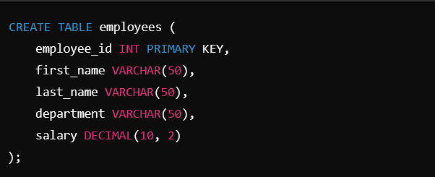
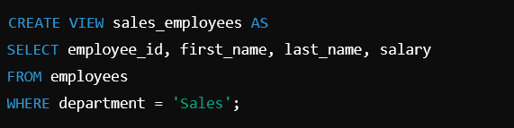
Creating a View
Creating a view is a straightforward process that involves defining a SELECT query and assigning it to a view name.
Example code: Consider a database with a table ‘employees
Create a view to display the employees in the ‘sales’ department

Slide 4

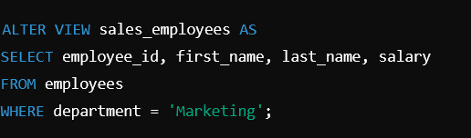

Querying a view:
Modifying a view:
Dropping a view:

Slide 5
Practical Real-World Example Summaries
1. Financial Services
Use Case: Generating Financial Reports
2. Healthcare
Use Case: Patient Records and Billing
3. Retail and E-Commerce
Use Case: Customer Insights and Sales Reports
4. Education
Use Case: Student Performance and Records
5. Human Resources
Use Case: Employee Management and Reporting

Slide 6
Views are a powerful feature in SQL that provide a way to represent the result of a SELECT
query as a virtual table. They offer several benefits, including simplified querying, enhanced security,
and data abstraction. Understanding how to create, query, and manage views is essential for effective
database management and application development. Views are a vital tool in SQL for managing data
complexity, ensuring security, providing a stable data interface, and promoting reusability. By understanding
how to effectively create and use views, businesses can streamline their data operations, enhance security,
and provide consistent and simplified data access to their users.

Slide 7
THANK YOU

